Slide 1



ONLINE
SPORTS
RETAIL
REVENUE

Slide 2
Here I analyze product data for an online sports retail company to optimize revenue.
This dataset contains five tables -
Info- contains product id with its name and description.
Finance -contains product id with its listing price, sale price, discount, and revenue.
Reviews -contains product id with its rating and number of reviews.
Traffic - contains product id and it last visited date on the website.
Brands -contains product id and its brand.
All Tables have the product id as a primary key

Slide 3

in this project, I utilize various data types, including numeric, string, and timestamp data, focusing on pricing,revenue, ratings, reviews, descriptions, and website traffic.
Employing functions like aggregation, cleaning,
labeling, Common Table Expressions, and correlation, my goal is to provide recommendations for the company to maximize revenue.

Slide 4

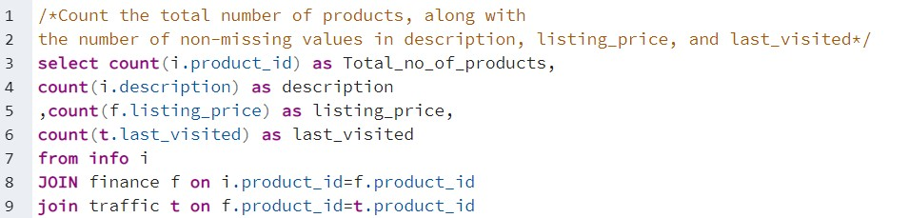
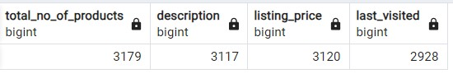

Slide 5
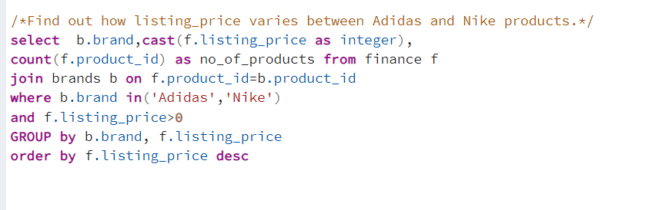
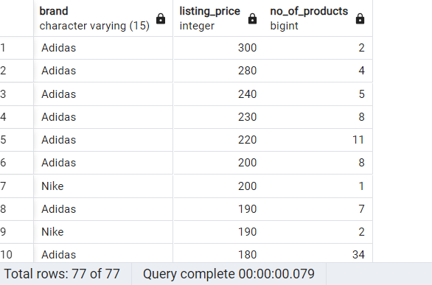


Slide 6
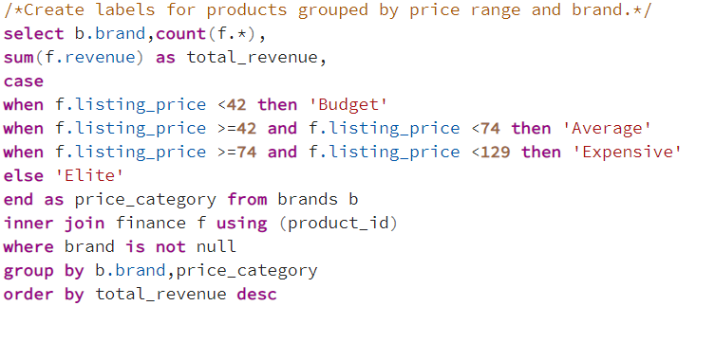
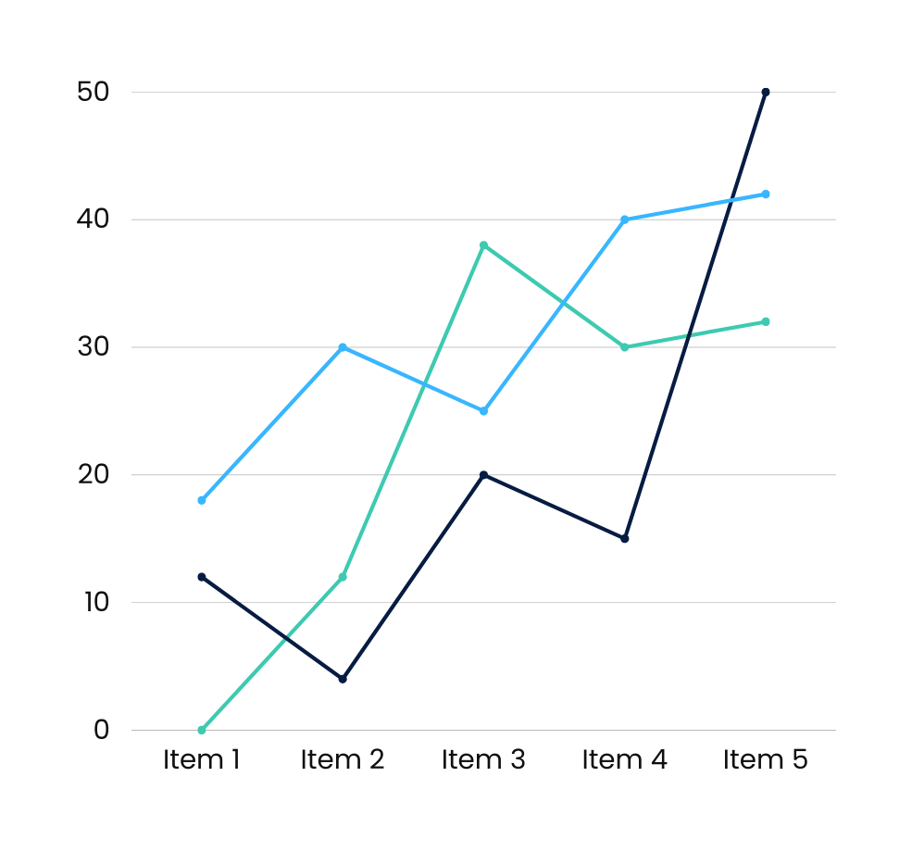
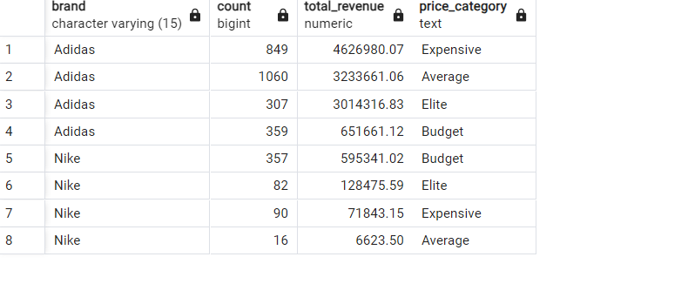

Slide 7
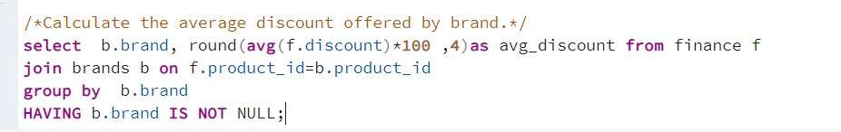
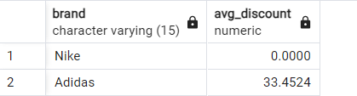

Slide 8
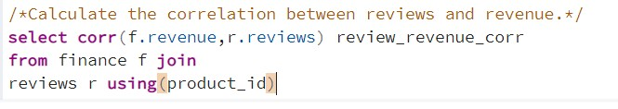
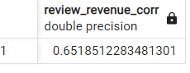
Free Plan

Slide 9
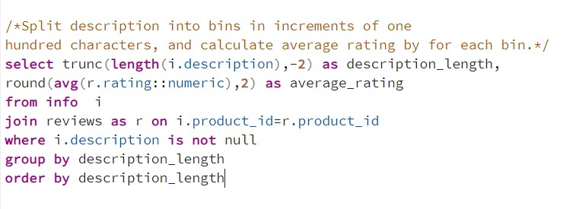
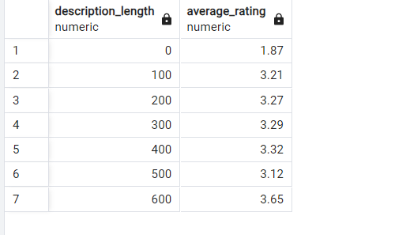

Slide 10
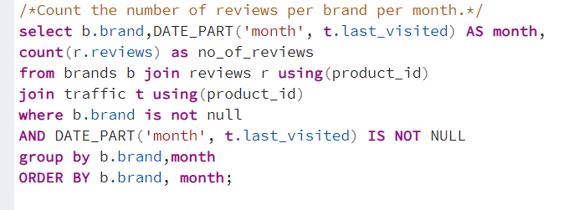
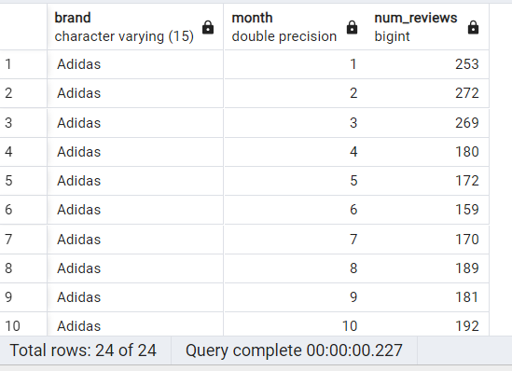

Slide 11
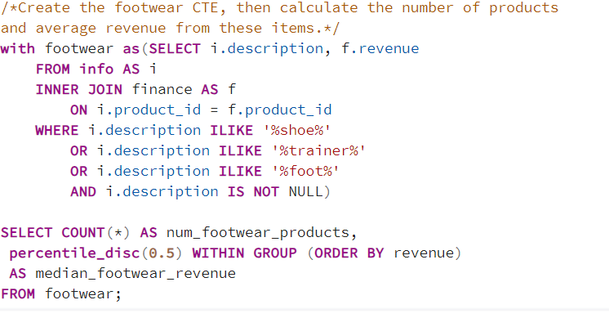
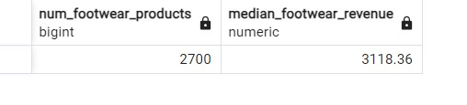

Slide 12
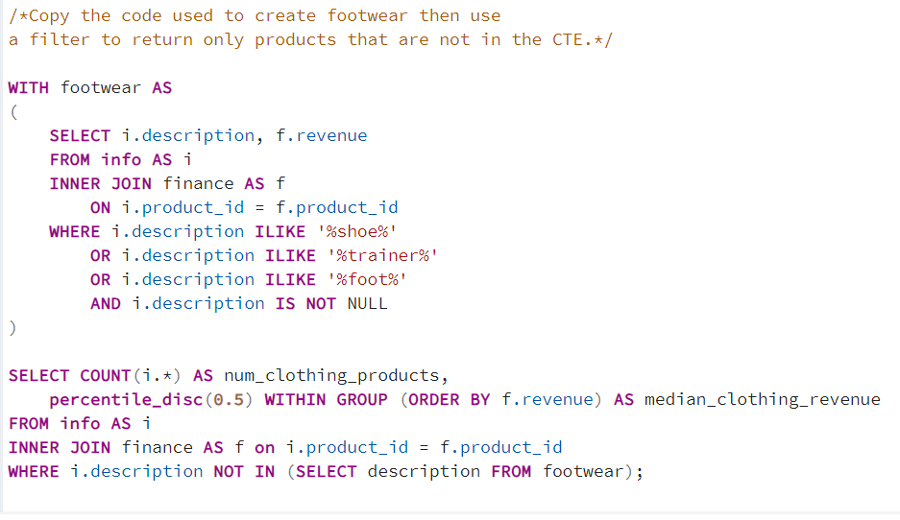
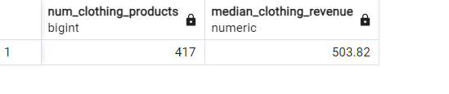

Slide 13
1 The store has much more Adidas products than Nike products.
2 For all products, Adidas has an average discount of 33.45% while Nike has zero
3 Product's description length doesn't affect the rating of the product that much.
4 Adidas pieces are much pricier than Nike.
5 Adidas has much greater number of reviews than Nike
along the months of the year.
6 There are 2,700 footwear products and 417 clothing products

